Slide 1

3.3. Introduction to Real-time Physics III
Continued overview of core principles behind real-time physics systems

Slide 2
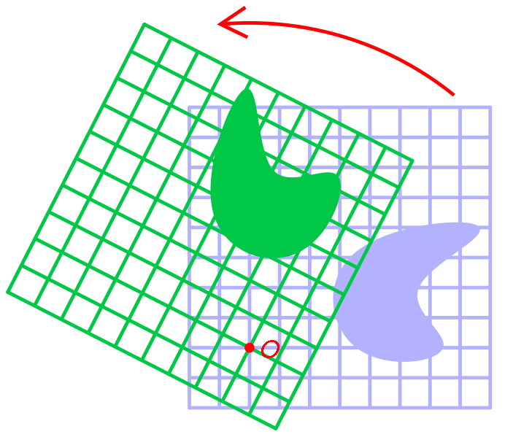
Object Orientation and Rotation
Representation of rotation

Slide 3
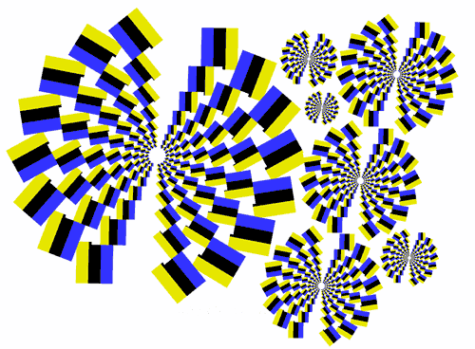
Object orientation and rotation
In two or three dimensions an object can be described as having a certain position (relative to some defined origin) and orientation (relative to some defined direction).
If the object is rotating, its orientation will change over time. Angular velocity represents the first derivative of orientation (c.f. linear velocity as the first derivative of position).
Whilst it was easy to model position and linear velocity, the same cannot be so readily asserted of orientation.

Slide 4

3D Orientation: Euler angles
In 3D, an object has three degrees of freedom for rotation. By analogy with the movement of aircraft we can call these yaw, pitch, and roll
For an aircraft these rotations are about the three local axes: pitch about X axis, yaw about Y axis, and roll about Z axis (assuming an aircraft is looking down the Z axis, with the Y axis up). An Euler angle representation of orientation is a vector where each component represents the rotation along a corresponding axis.
Aside: NASA’s Apollo moon program had to deal with Gimbal lock and (otherwise) arbitrary restrictions were placed on the way astronauts could move the craft to prevent software gimbal lock problems (a warning noise was triggered if an orientation resulting if gimbal lock was approached)

Slide 5
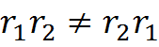
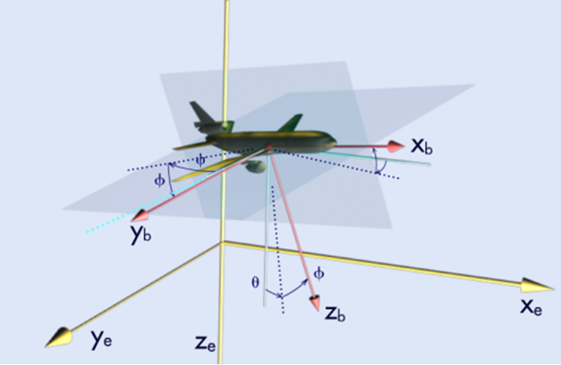
3D Orientation: Euler angles
Whilst Euler angles have been widely used in graphical applications, they present a number of problems. In particular, changing the order in which the individual axis rotations are applied results in a different outcome, i.e.:
This introduces problems when combining two or more rotations.
Additionally, if the rotational axes are fixed (e.g. to the world x, y and z axes) then the issue of gimbal lock arises whereby a rotation results in one axis being aligned with another (thereby preventing any further rotation around that particular axis).

Slide 6
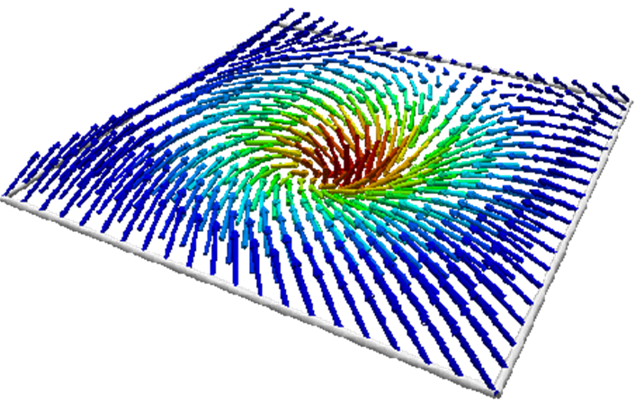
3D Orientation: Axis-angle Representation
Any rotation (and hence any combination of rotations) in 3D can be represented as a single rotation about a fixed axis (i.e. specified using an axis and an angle).
The scaled axis representation combines the axis and angle into a single vector, where the direction of the vector gives the axis and the magnitude of the vector gives the angle in the range [0, π] (a negative angle is equivalent to a positive rotation in the opposite direction).
This is a compact orientation representation but when representing rotations the mathematics involved in combining two rotations is not straightforward.

Slide 7
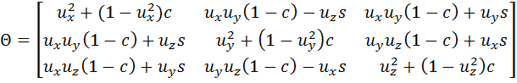
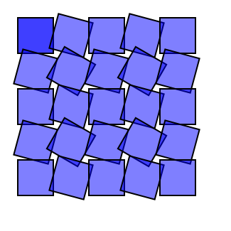
3D Orientation: Rotation Matrices
Until recently the most common means of representing orientations was to use a rotation matrix. This is convenient as rendering engines within games use matrices to represent transformations (including rotations).
Any rotation can be represented within a matrix as:
[u_{x}, u_{y}, u_{z}] represents the rotation axis and c = cos θ s = sin θ, θ is the angle.
Combining two rotations is accomplished by multiplying the two matrices together. The downside with using matrices is representing a three-degree-of-freedom system with nine numbers. This is more sensitive to errors due to floating point inaccuracies, which can, eventually result in non-rotational transformation.

Slide 8
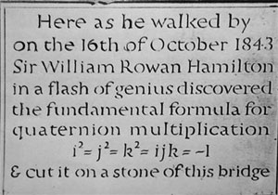
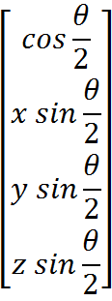
3D Orientation: Quaternions
A quaternion probably offers the best means of represented an orientation within the context of games programming. In particular, an orientation can be defined using four values as:
Where x, y, and z define the axis around which the rotation is to be applied and θ holds the amount of rotation .

Slide 9
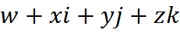
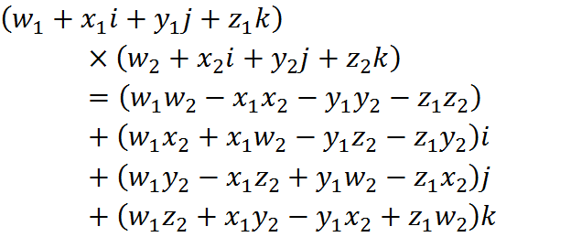
3D Orientation: Quaternions
The mathematics behind quaternions is unfortunately not straightforward. A quaternion is defined as a number of the form
Where i, j and k are imaginary numbers (i.e. i² = j² = k² =−1) and ijk = -1. Importantly, quaternion mathematics isn’t commutative (i.e. ab ≠ba), with ij=−ji = k, jk=−kj = i, ki=−ik = j.
Using the above, two quaternions can be multiplied together as:

Slide 10
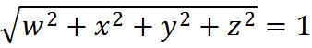
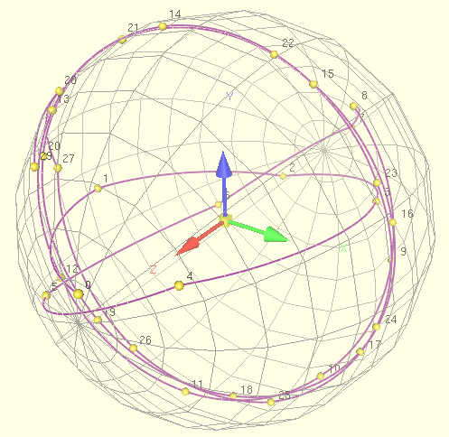
3D Orientation: Quaternions
Crucially, if the original two quaternions represent rotations (as defined above), then the resulting quaternion is equivalent to the two rotations combined.
As defined, all orientation quaternions will have a length of exact one. The length of a quaternion is determined using Pythagoras’s theory. For orientations a quaternion can be normalised in the same way as for a normal vector.
A normalised quaternion can be thought of as giving a point on the surface of a four-dimensional sphere.
Due to floating point numerical inaccuracies, it is good practice to re-normalized quaternions following the application of several numerical operations.

Slide 11
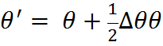
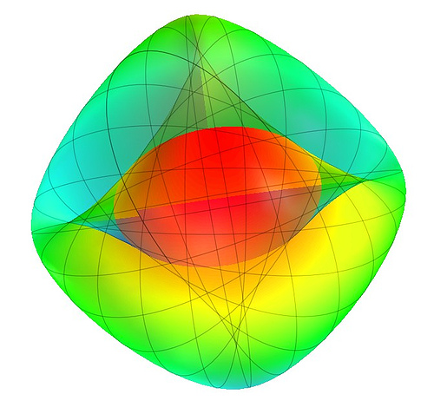
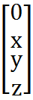
3D Orientation: Quaternions: Rotating
Assume a scaled axis representation is used to represent an amount of rotation. An orientation quaternion, θ, can be updated to include an added amount of rotation as follows:
Where Δθ is a (non-normalised) quaternion holding the angular change built from a scaled axis representation of the amount of rotation and is formed using the x, y and z rotation components as:

Slide 12
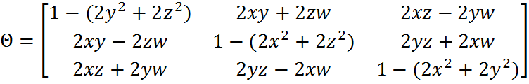
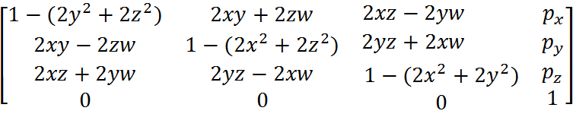
3D Orientation: Quaternions: Matrix Conversion
In order to convert a quaternion into a 3x3 rotation matrix or a 4x4 transform matrix (e.g. when converting a rotation into a transform to be used during rendering) the axis and angle is extracted from the quaternion and then converted into rotation matrix form as:
where w, x, y, and z are the components of the quaternion. When expressed as a 4x4 transform matrix this becomes (where p_{x}, p_{y}, p_{z} is the centre position):

Slide 13
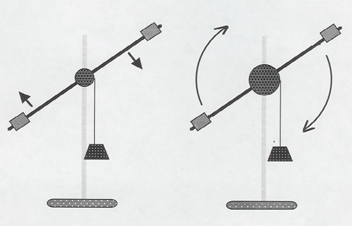
Angular Velocity and Acceleration
Modelling of angular velocity and acceleration

Slide 14
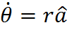
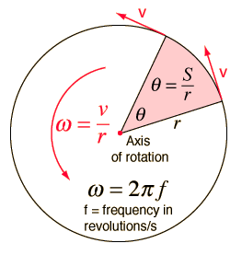
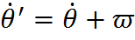
Angular Velocity
The scaled axis representation can be used to represent the direction and speed of rotation, i.e. the angular velocity can be decomposed into an axis and rate of angular change as (where a is the axis of spin and r is the rate of spin in radians s⁻¹)
This representation entails that two angular velocities can be simply added together, using vector arithmetic, to build the resultant net angular velocity, i.e. if an object is spinning with an angular velocity of , an additional angular velocity, can be combined with to provide the new angular velocity:

Slide 15
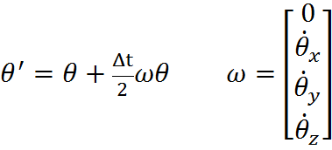
Angular Velocity
In order to update an orientation, expressed as a quaternion, using an angular velocity, the following equation is used:
i.e. ω is a quaternion constructed with a zero w component and the remaining components taken from the angular velocity.
Aside: ω does not represent an orientation (and need not be normalised)

Slide 16
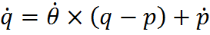

Aside: Velocity of a point
The velocity of a point on an object depends on both its linear and angular velocity, as follows:
Where is the velocity of the point, q is the position of the point in world coordinates, p is the position of the origin of the object, and is the angular velocity of the object.

Slide 17
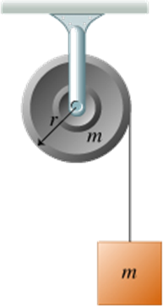
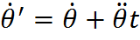
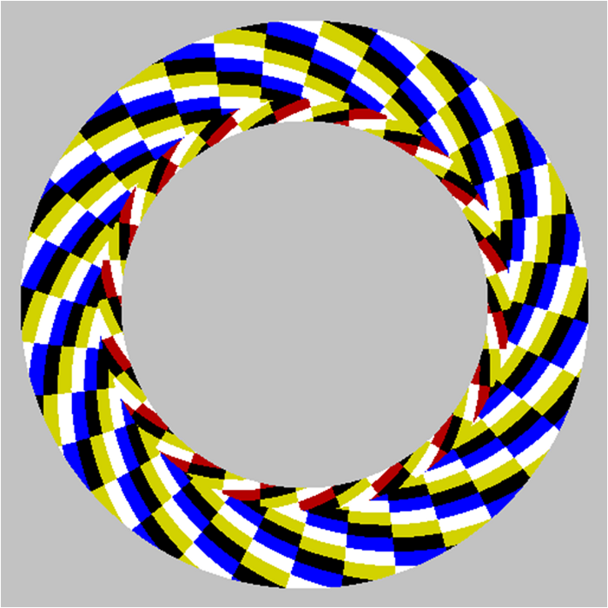
Angular Acceleration
The angular velocity can be updated using an angular acceleration in the same way linear velocity can be updated using a linear acceleration, i.e.

Slide 18
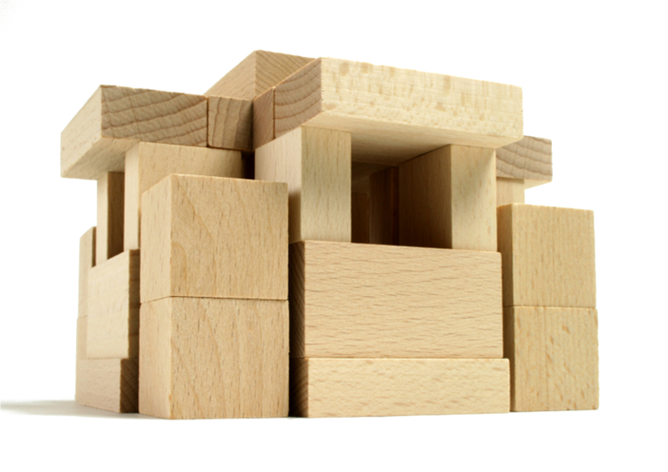
Laws of Motion for Rigid Bodies
Applying Newton’s Law of Motions to rigid bodies

Slide 19

Video not available in on-line slides

Slide 20
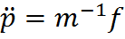

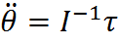
Newton’s 2nd Law Applied to Rotation
Newton’s 2nd law of motion links a change in linear velocity to an applied force as:
A similar law exists for rotations, in particular, the change in angular velocity depends on the application of a torque, τ, as transformed through a moment of inertia, I, as:

Slide 21
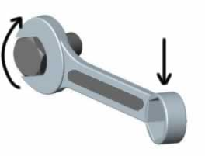
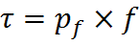
Torque
Torque can be thought of as a rotating, or twisting, force, e.g. turning a volume knob on a radio using a twisting force (i.e. torque).
The amount of angular acceleration which occurs following the application of a twisting force depends on both the size of the force and where the force is applied relative to the axis of rotation (i.e. it is easier to turn a stiff nut using a long handled wrench)
The equation that links force and torque is (where f is the applied force, and p_{f} is the point of application relative to the axis of rotation (e.g. centre of mass of the object):

Slide 22
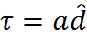
Aside: Arbitrarily, torque can be considered as acting in a clockwise direction around the axis of application (i.e. the corresponding counter clockwise torque is obtained by inverting the direction of the axis).
Torque
A torque can be expressed using a scaled axis representation:
Where a is the magnitude of the torque and d is a unit-length vector in the axis around which the torque applies.
Whenever a force is applied to a body it will be necessary to decompose the force into a component that produces linear acceleration and a component that generates a torque (explored shortly) If the applied force passes directly through the centre of mass of an object, then no torque is generated
No torque is generated.

Slide 23

Moment of Inertia
The moment of inertia is akin to the rotational equivalent of mass, determining how difficult it is for an applied torque to result in a change of rotational speed.
It differs from mass in that inertia depends upon the axis of spin to which the torque is applied.
In particular, the moment of inertia depends on the mass of the object and the distance of that mass from the axis of rotation (the greater the distance, the more difficult it is to rotate a given mass).
.

Slide 24
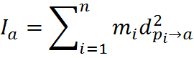
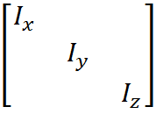
Aside: A tensor is simply a generalised matrix, i.e. a tensor can be through of as an n-dimensional array. In this case, n=2, i.e. it’s a matrix.
Moment of Inertia
The moment of inertia about an axis in terms of a set of particles in the object is:
where n is the number of particles, d_{pi→a} is the distance of particle i from the axis of rotation a, and I_{a} is the moment of inertia about that axis.
It is possible to compactly represent the moments of inertia within a matrix structure, forming what is known as an inertia tensor.
The inertia tensor in three dimensions is a 3 × 3 matrix. For a given rigid body, the leading diagonals within the tensor hold the moment of inertia about each of its local axes, i.e. I_{x} is the moment of inertia of the object about its X axis thought its centre of mass, etc.

Slide 25
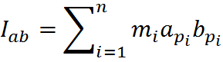
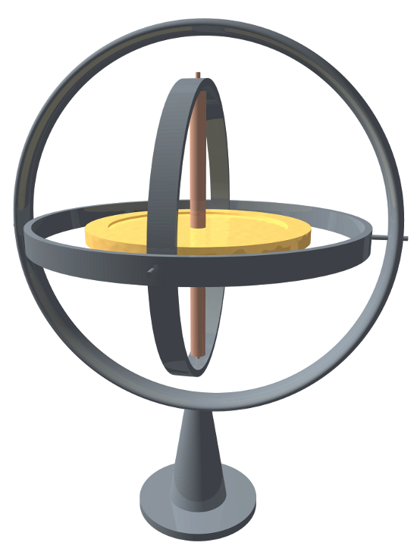
Moment of Inertia
The remaining entries within the inertia tensor hold products of inertia, defined as
Where a_{pi} is the distance of particle i from the centre of mass of the object, in the direction of a. Using this I_{xy}, I_{xz} and I_{yz} can be calculated, e.g. I_{xy} holds the sum of the products of mass dependent upon the distance of the particle along the x- and y-axis relative to the centre of mass.
A product of inertia represents the tendency to rotate in a direction different from the direction in which torque is applied. For some objects rotation may occur about a different axis from that which the torque was applied (e.g. a gyroscope).

Slide 26
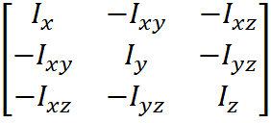
Moment of Inertia
Including the products of inertia completes the inertia tensor:
In terms of the equation linking an applied torque to an increase in angular velocity, i.e. the inertia tensor developed above is simply inverted.

Slide 27
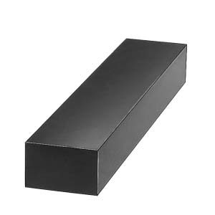
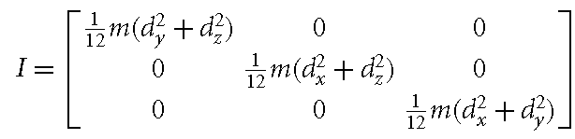
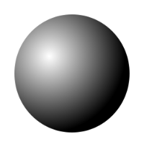
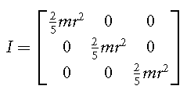

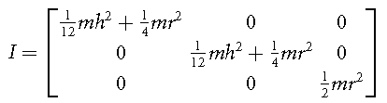
Moment of Inertia: Common shapes
Some common inertia tensors for common shapes are as follows:
Rectangular block of mass m and dimensions d_{x}, d_{y}, and d_{z} aligned along the x-, y-, and z-axes, respectively:
Solid sphere of mass m and radius r:
Cylinder of mass m, with a principle axis along the z-axis, radius r and height h:

Slide 28
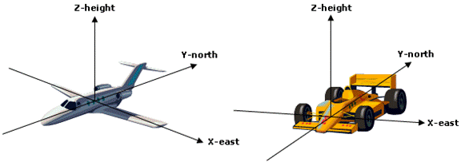
Moment of Inertia: World Coordinates
An inertia tensor is typically expressed in terms of the object’s local coordinate system, whilst torque and angular acceleration are typically expressed in terms of world coordinates.
Hence, within the physics engine it will be necessary to build each frame an inverse inertia tensor expressed in terms of world coordinates in order to apply any accumulated torque to a given body.

Slide 29
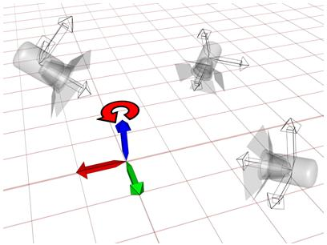
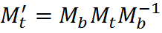
Aside: Changing the basis of a matrix
In what follows there will be a need to apply in world space a transformation that is expressed in terms of a local space.
Assume that M_{b} is a matrix transform which converts from an original basis B₁ into a new basis B₂ (i.e. it may be a world transform converting from local space coordinates into world space). Further assume that M_{t} is a matrix transform currently defined in terms of B₁ that is to be applied within B₂. This can be accomplished by:
Applying an inverse transform M_{b}⁻¹ that converts from B₂ into B₁
Performing the desired M_{t} transform
Applying the M_{b} transform to convert from B₁ back into B₂
Reminder: Multiplied matrices are equivalent to transformations carried out in reverse order.

Slide 30
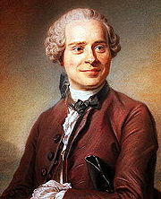
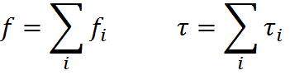
D 'Alembert’s Principle
D’Alembert’s principle deals with the application of multiple forces acting on a particular system.
It is of use when considering the effect of applying multiple forces to a body as it allows permit the a single resultant force to generated. The effect of the one accumulated force is identical to the effect of all its component forces.
The principle states that:
Hence, within the physics engine two accumulators will be used, one for forces and one for torque. Any applied force will be added to both the force and torque accumulator (using )

Slide 31

Directed Reading
Directed
reading
Directed physics reading

Slide 32

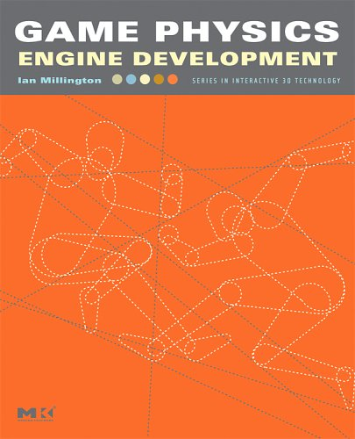
Directed reading
Directed
reading
Read Chapter 9 of Game Physics Engine Development (pp145-191) on rotations.
Read Chapter 10 of Game Physics Engine Development (pp193-212) on the laws of motion for rigid bodies.

Slide 33

Summary
Today we explored:
How to model orientation and rotation
Laws of motion for rigid bodies
To do:
Read the directed reading.
Consider if you might wish to develop your own physics engine as your project.

